Slide 1

Vel Tech Rangarajan Dr. Sagunthala R&D Institute of Science and Technology
School of Computing
Department of Computer Science and Engineering
10211CS224 / FULL STACK APPLICATION DEVELOPMENT (JAVA)
PROJECT REVIEW : MILESTONE PROJECT – 1
Date: 06-03-2026
Relational Inventory Control & Stock Tracking System
SDG: SDG 9 – Industry, Innovation and Infrastructure
Presented By:
K.Sai Srujana – VTU25926 – Reg.No:23UECS0301.
Courses Handling Faculty:
Dr.D.AMU- - Designation

Slide 2
INTRODUCTION
Managing inventory manually is time-consuming and prone to errors, especially for businesses with multiple products and suppliers.
This project provides a digital solution to track stock levels, products, and suppliers efficiently.
It helps prevent stock shortages, overstocking, and errors in product management, saving time and money.
The system offers real-time visibility of stock and supplier details for informed decision-making.
Users can easily add, update, and view products and suppliers through a user-friendly interface
Organizing inventory data systematically reduces human errors and enhances operational efficiency.
The project uses relational databases to maintain accurate records and ensure data integrity.
Overall, it is a practical tool for businesses to streamline inventory operations and boost productivity.
1
2
3
4
5
6
7
8
9

Slide 3
PROBLEM STATEMENT
In many small businesses, managing inventory of stationary items is done manually, which is time-consuming and prone to errors.
Stock levels, product details, and supplier information are often not updated in real-time, leading to overstocking or shortages.
Manual record-keeping makes it difficult to track product movement and generate accurate reports.
Businesses face challenges in maintaining organized and reliable data for multiple products and suppliers.
There is a need for a simple and automated system to manage inventory efficiently.
Such a system should allow easy addition, updating, and viewing of products and suppliers.
A digital solution can reduce errors, save time, and improve decision-making for inventory management.
The proposed system aims to provide a reliable, user-friendly platform to streamline stationary inventory control.
1
2
3
4
5
6
7
8
9

Slide 4
OBJECTIVE(S)
To design and develop a relational inventory management system for stationery items.
To implement automated tracking of products, stock levels, and supplier details.
To improve efficiency and reduce errors in inventory management.
To provide real-time visibility of stock availability for better decision-making.
To evaluate the performance of the system in managing and updating inventory records accurately.
1
2
3
4
5
6
7
8
9

Slide 5
PROPOSED SYSTEM
The system provides a centralized database to store all product, stock, and supplier information.
It automates inventory management, reducing manual effort and human errors.
Stock levels are monitored in real-time, helping to prevent overstocking or stockouts.
Product details, including supplier information, are easily accessible for quick reference.
The system generates organized reports of products and stock for better decision-making.
User-friendly forms allow adding, updating, and deleting products or suppliers efficiently.
Compared to manual systems, it offers faster processing, higher accuracy, and consistency.
The system ensures data integrity and security using relational database constraints.
1
2
3
4
5
6
7
8
9

Slide 6
PROPOSED SYSTEM ARCHITECTURE
Input
Users enter product details, stock quantity, and supplier information through forms.
Login credentials are provided for authentication and access control.
Selection inputs, such as choosing a supplier for a product, are submitted for processing.
Processing
PHP scripts validate user input and apply business logic.
The system updates product stock, adds new products, or modifies supplier data.
Low-stock alerts and inventory calculations are generated automatically.
Database
Products Table stores product name, price, stock quantity, and supplier ID.
Suppliers Table maintains supplier name, phone, and location.
Users Table keeps track of usernames, passwords, and user roles.
Output
Displays product lists, stock levels, and supplier information on the web interface.
Generates alerts for low-stock items to assist inventory management.
Provides easy-to-read reports for decision-making and order planning.
1
2
3
4
5
6
7
8
9

Slide 7
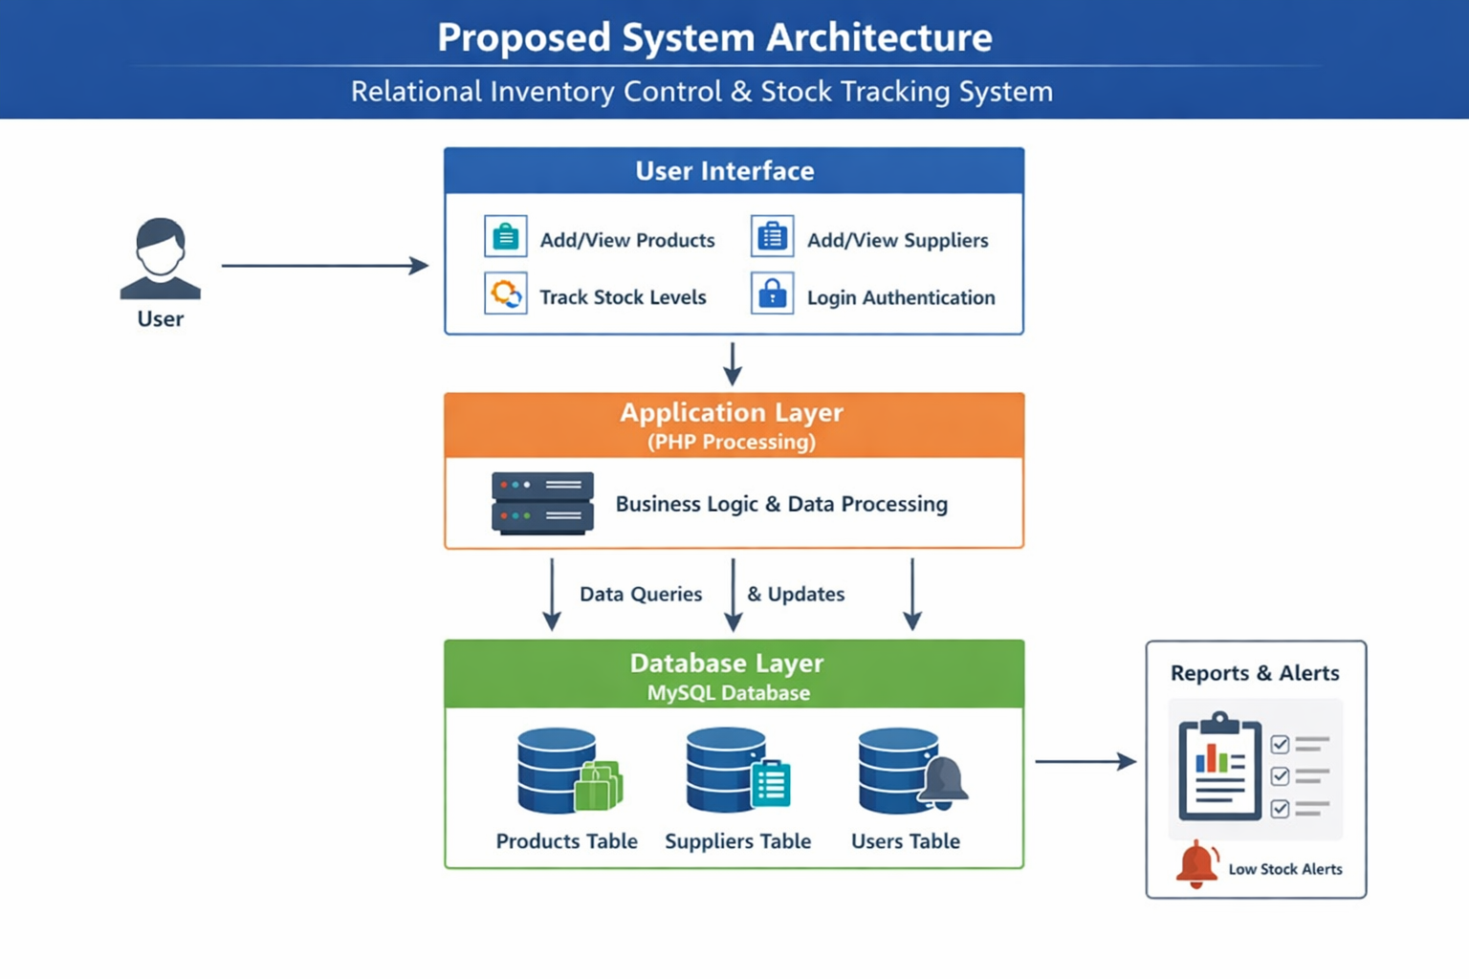
WORKFLOW
1
2
3
4
5
6
7
8
9

Slide 8
TECHNOLOGIES USED
Frontend:
HTML – For structure of web pages.
CSS – For styling the interface (including tables, forms, and login page).
Backend:
PHP – Server-side scripting to handle form submissions, process data, and interact with the database.
Database:
MySQL – Stores all data including products, suppliers, and users..
Relational design – Uses foreign keys to maintain relationships between products and suppliers.
Tools:
Visual Studio Code / Any code editor – For writing HTML, PHP, and CSS.
XAMPP / WAMP – Local server environment to run PHP and MySQL.
phpMyAdmin – To manage the MySQL database.
Hardware:
Desktop or Laptop with minimum 4GB RAM.
Processor: Intel i3 or equivalent.
At least 20 GB free storage.
Software:
Operating System: Windows/Linux/MacOS.
Web Browser: Chrome, Firefox, or Edge.
XAMPP/WAMP installed to run Apache and MySQL server.
1
2
3
4
5
6
7
8
9

Slide 9
MODULE DESCRIPTION
Module 1: User Management
Handles user login, authentication, and management of user roles (admin or staff) to securely access the system.
Module 2: Product Management
Allows adding, updating, and viewing stationary products with details like name, price, stock, and supplier.
Module 3: Supplier Management
Manages supplier details including name, phone number, and location, and links products to suppliers.
Module 4: Stock Tracking
Monitors product inventory levels, highlights low-stock items.
1
2
3
4
5
6
7
8
9

Slide 10
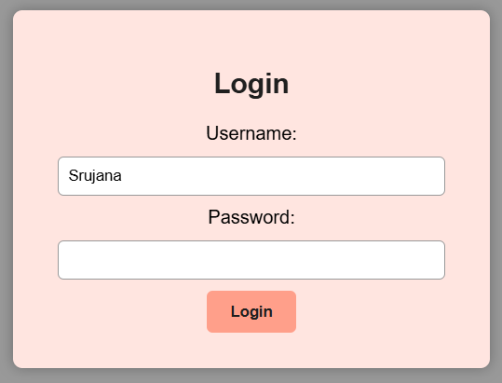
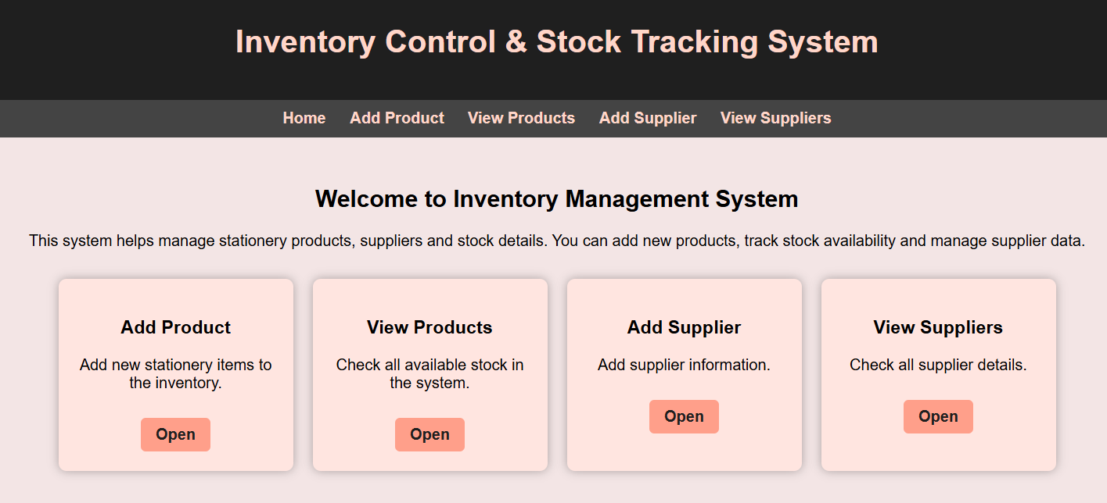
IMPLEMENTATION SCREENSHOTS
1
2
3
4
5
6
7
8
9

Slide 11
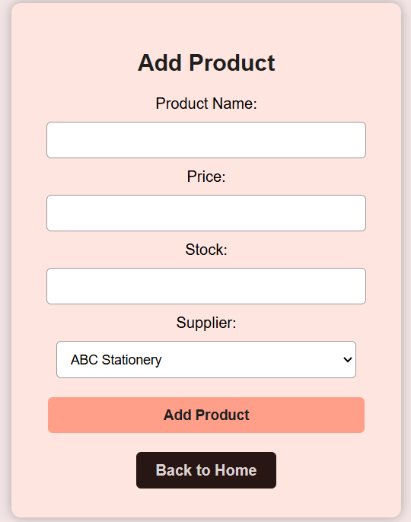
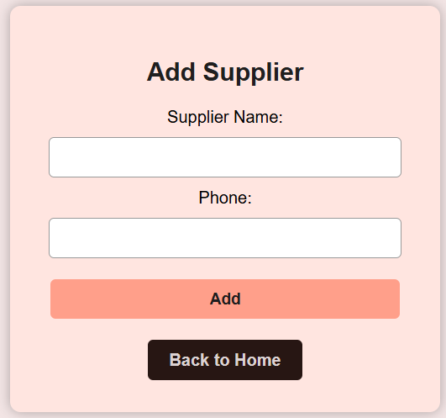
IMPLEMENTATION SCREENSHOTS
1
2
3
4
5
6
7
8(A)
9

Slide 12
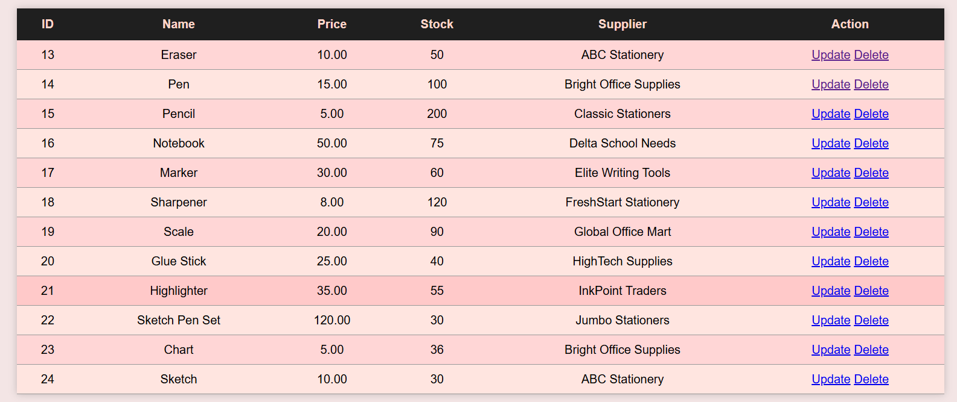
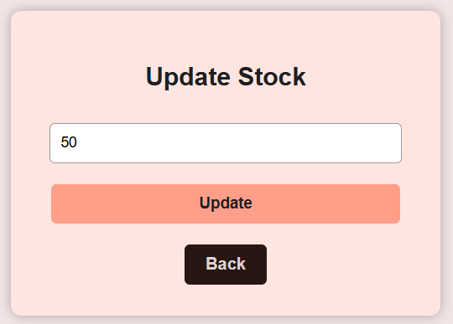
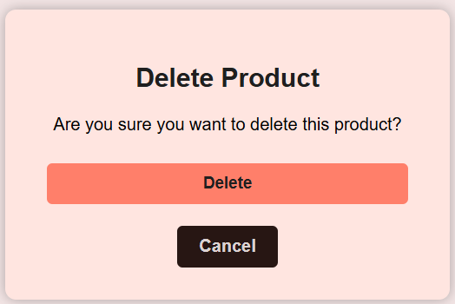
IMPLEMENTATION SCREENSHOTS
1
2
3
4
5
6
7
8(B)
9

Slide 13
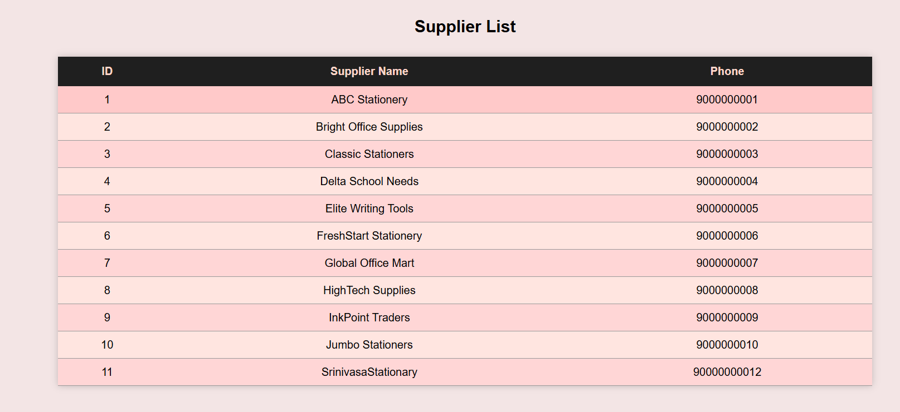
IMPLEMENTATION SCREENSHOTS
1
2
3
4
5
6
7
8(C)
9

Slide 14
ADVANTAGES & LIMITATIONS
1
Advantages
Automated Inventory Management – Reduces manual work and human errors.
Real-time Stock Monitoring – Provides instant visibility of product availability.
Supplier Integration – Keeps supplier details organized and linked with products.
Time & Cost Saving – Minimizes manual labor and reduces the risk of overstocking or stock-outs.
Limitations
Dependency on Database – System cannot function if the database fails.
Initial Setup Required – Needs proper configuration and initial data entry.
Limited Scope – Currently designed for stationery items only.
No Offline Functionality – Cannot operate when offline or during network issues.
2
3
4
5
6
7
8
9

Slide 15
Thank you

